Slide 1
eOPF
Electronic Official Personnel Folder for Employees

Slide 2
What is eOPF?
The eOPF is the digitized re-creation of your hard copy Official Personnel File (OPF) which is currently the official record of your federal work career.
eOPF allows each employee to have an electronic access to their own personnel folder. Some unique system features include:
Provides secure access to employment documents/official forms and information to a geographically dispersed workforce,
Supports a multi-level secure environment,
Eliminates loss of an employee’s official personnel folder during filing and/or routing ,
Reduces costs associated with storage, maintenance, and retrieval of records,
Complies with Office of Personnel Management (OPM) and federally mandated HR employee record management regulations , and
Delivers system generated email notification to employee.

Slide 3
Accessing your eOPF
You can only access eOPF from a Government computer with internet access on a Government installation/location
The eOPF login is not CAC enabled, when you create your password it only lasts for 60 days so remember to update it when needed.
https://eopf1.nbc.gov/nationalguard/logon.aspx
You will need to request you eOPF ID
Once you request your eOPF ID you will receive an email to your military email with the ID and then go back to the eOPF login page
You will request a new password by clicking on the “Request a New Password” link on the eOPF Login page. An email is then sent with a password reset link, a reset token, and instructions to the email address of record in eOPF. The token is valid for 15 minutes. When you click on the reset link, they will be prompted to enter your eOPF D and token. Once submitted, you will create a new password

Slide 4
What is in my eOPF?
The documents that were in your hard copy OPF.
Human Resources documents - some examples are as follows: SF 50s, SF 52s, Position Description(s), resume(s), and any other supporting
documentation for hiring actions.
Benefits Forms.
Performance Documents.
Military Forms, e.g., DD-214.

Slide 5
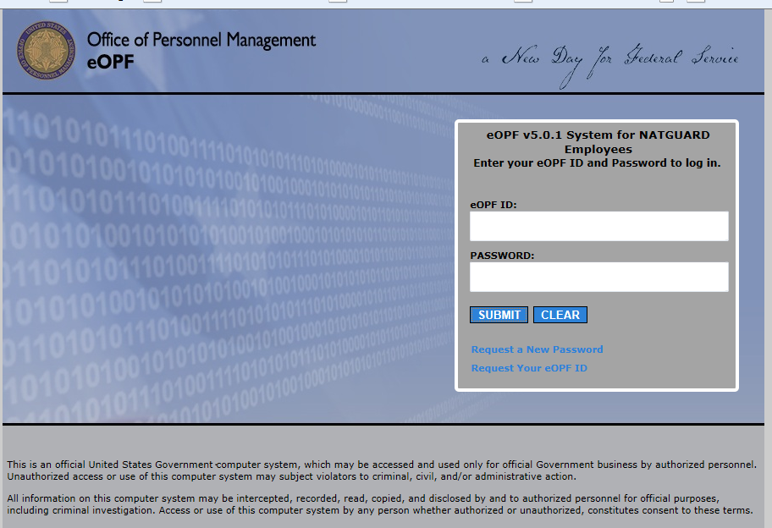
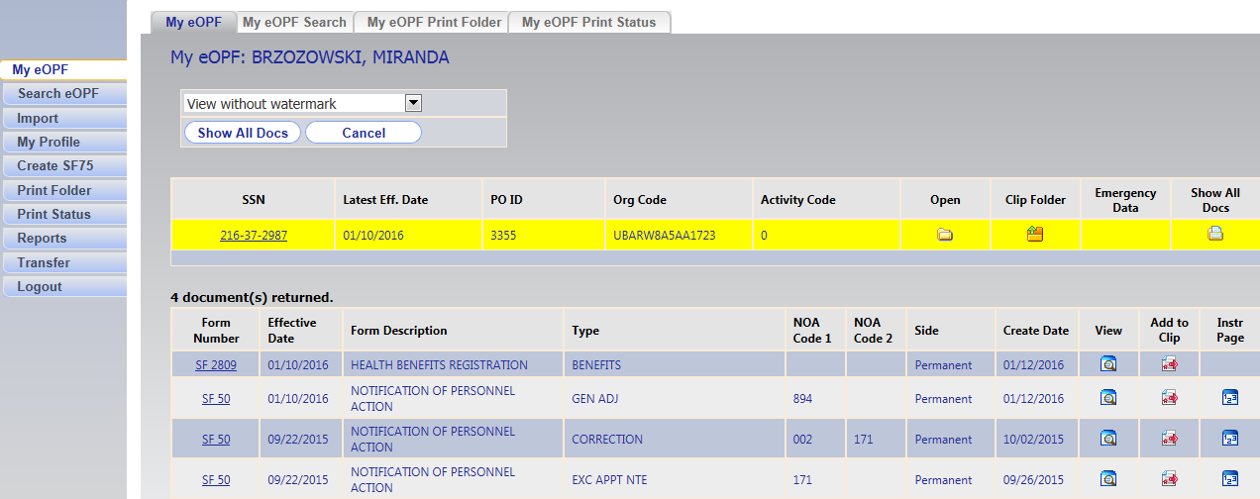
What you can do in eOPF?
Access eOPF from any Government computer with internet access on a Government installation/location.
View, Search and Print Documents
Update My Profile:
Who Am I?
General preferences
Change password
Change security questions
View Help & Frequently asked questions
Reset your Password and User ID
Request additional assistance

Slide 6
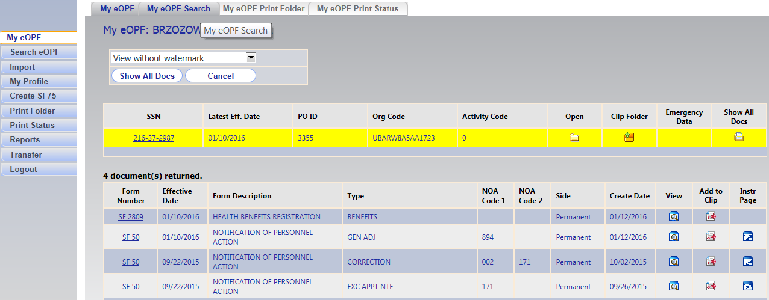
How to view documents
In the “My eOPF” tab you can view all of your documents
If you want to search for a specific document; use the “My eOPF search” tab

Slide 7
How to print your documents
You can view and/or print all documents from your eOPF.
To print one document you can click the view button and print it from the pdf file
To print your entire folder go to the “My eOPF Print Folder” tab then click “Print Single sided” then your print request will be forwarded to the print queue “my eOPF print status”

Slide 8
Print status feature
Printing has been modified for ‘Print Folder’, ‘Show All Docs in My eOPF’, ‘Show All Docs in Search eOPF’, and ‘Clip Folders’.
Users submit a print request which is handled by a dedicated print service.
Once a print job is completed, a bulk PDF file is created - the images (bulk PDF) are retained for an agency determined period of time (default of 7 days) before being purged.
Users will be provided a list of their own requests.

Slide 9
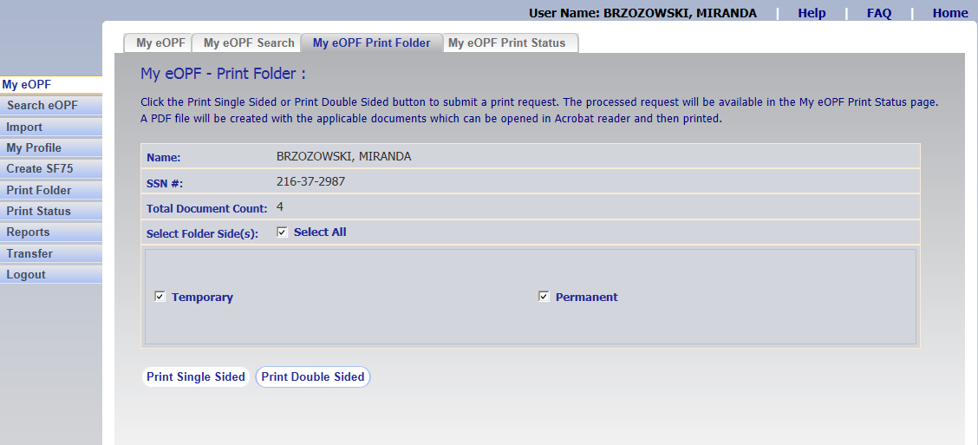

Slide 10
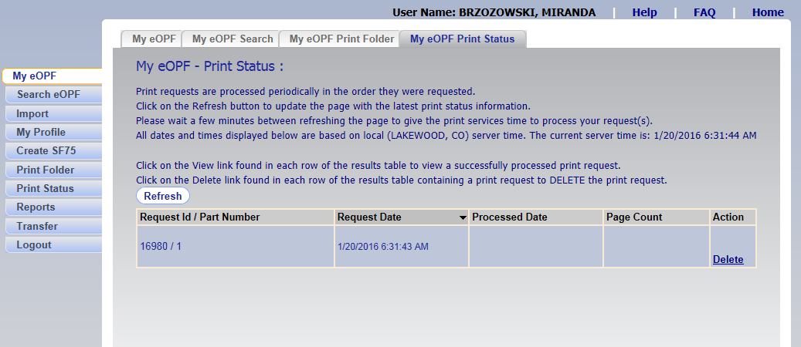

Slide 11
Searching documents
You can search for specific documents in the “My eOPF Search” tab
Select the “Common Forms” option and use the drop down menus for the exact type of file you want to view

Slide 12
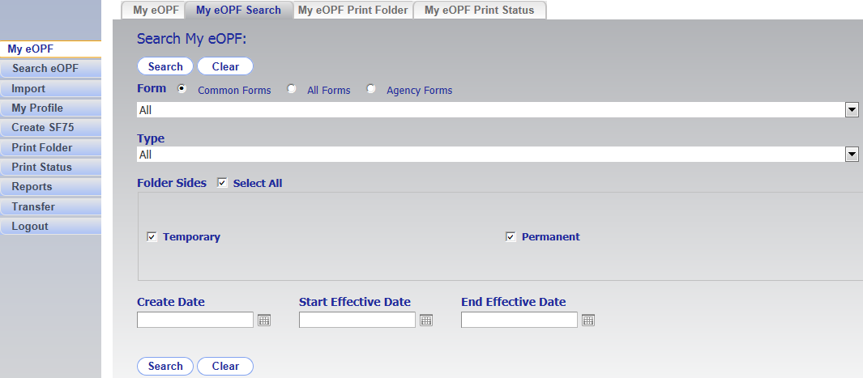

Slide 13
My Profile
A read-only view of a users own eOPF account
Information regarding the employee’s profile will help troubleshoot issues regarding privileges and access to folders.
In “My Profile” you can change your General preference, password and security questions
The “OK” button will return the user to the eOPF welcome page.

Slide 14
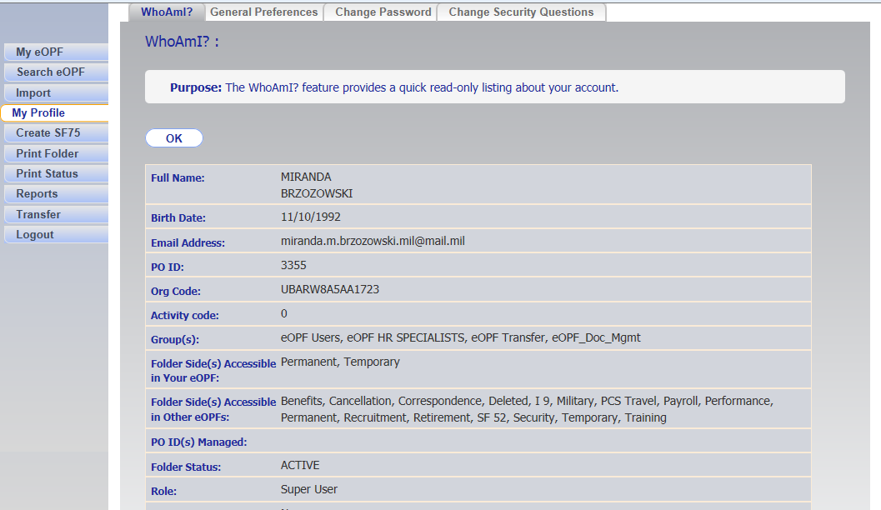

Slide 15
What happens to my records when I leave the agency?
Your personnel records are normally transferred to the National Personnel Records Center within 120 days after an employee's separation from Federal employment
When an employee leaves, the losing personnel office sends interagency personnel records to the next Federal employer. If the employee is leaving Federal service, the losing personnel office sends interagency personnel records to the National Personnel Records Center. When an employee separates from Federal service, the folders are stored by NPRC, National Personnel Records Center until retention requirements expire. Folders are retained for 65 years from date of last separation from Federal employment.
http://www.archives.gov/st-louis/civilian-personnel/index.html

Slide 16
What if I need help?
eOPF has an online help that you can view by clicking the word 'Help' at the top of most pages within the web site. The instructions in Help can be printed. If you are having system problems, please contact the eOPF Help Desk. The eOPF Help Desk can be contacted using the following methods:
Email: eopf_hd@telesishq.com
Phone: 866-275-8518

Slide 17
eOPF Summary
You can use any Government computer with internet access and on Government installations/locations to view your eOPF documents.
You can view and print documents when ever you need them.
You will need Internet Explorer and Adobe Acrobat Reader version 6 or later.

