Slide 1
Credentialing Assistance
When you first log in, instead
of clicking on Tuition
Assistance, click on
Credentialing Assistance

Slide 2
Credentialing Assistance
It will bring you to this page
where you will select
“Credentialing Assistance

Slide 3
Credentialing Assistance
Here you will be brough to a
page that will let you select
credentials based on your
MOS or Non-MOS related

Slide 4
Credentialing Assistance
To explore credentials, the
SM will go to Army COOL to
see the list of approved
credentials and vendors
If a credential or vendor is
not on this website, the SM
can request for it to be
added

Slide 5
Credentialing Assistance
When the SM knows what
credential they want to
pursue, they can search for
it by MOS or by the name

Slide 6
Credentialing Assitance
When they find their
credential, they can click on
it to bring them to the
overview of the credential
From this page they can
select “Create Education
Goal”

Slide 7
Credentialing Assistance
Here they will verify
the correct credential
name and submit their
goal

Slide 8
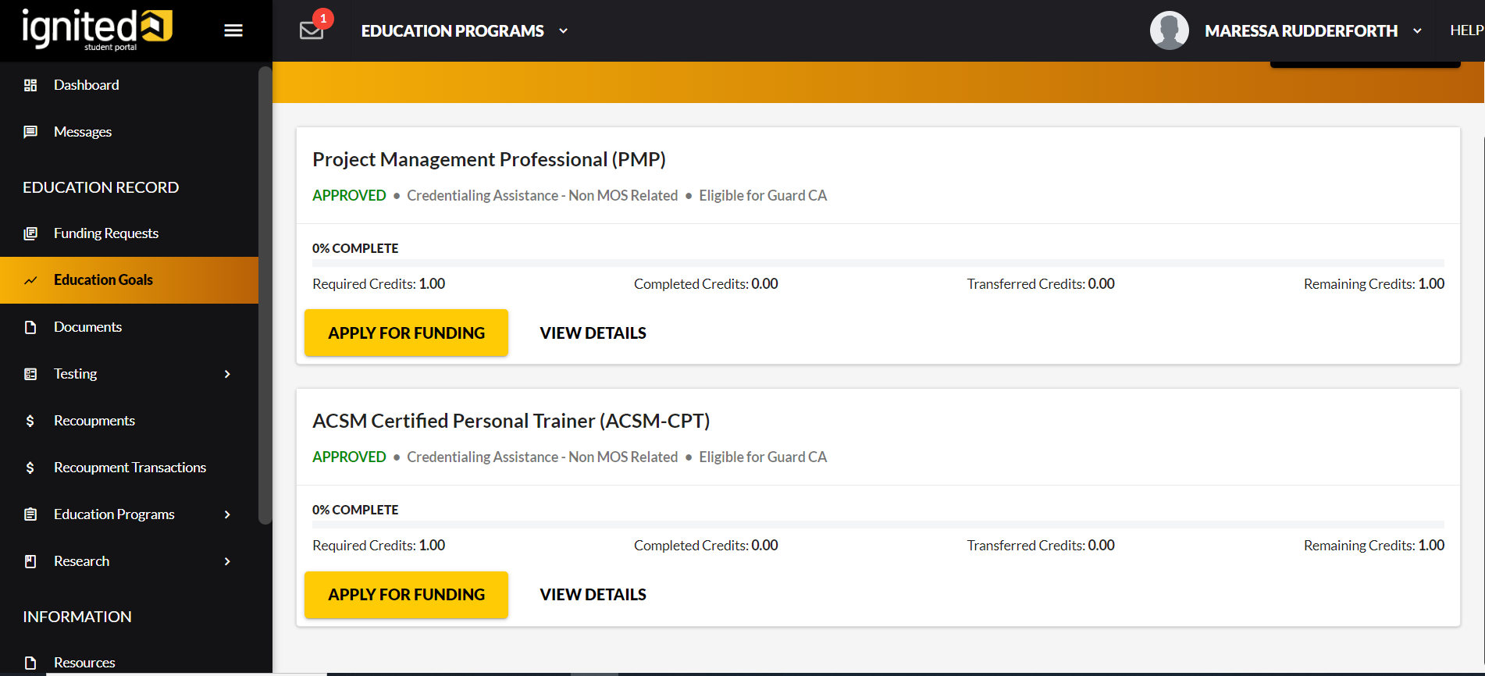
Credentialing Assistance
When they submit
their goal, the CA goal
is usually auto
approved
Here they can select
“Apply for Funding”
for the credential they
want to pursue

Slide 9
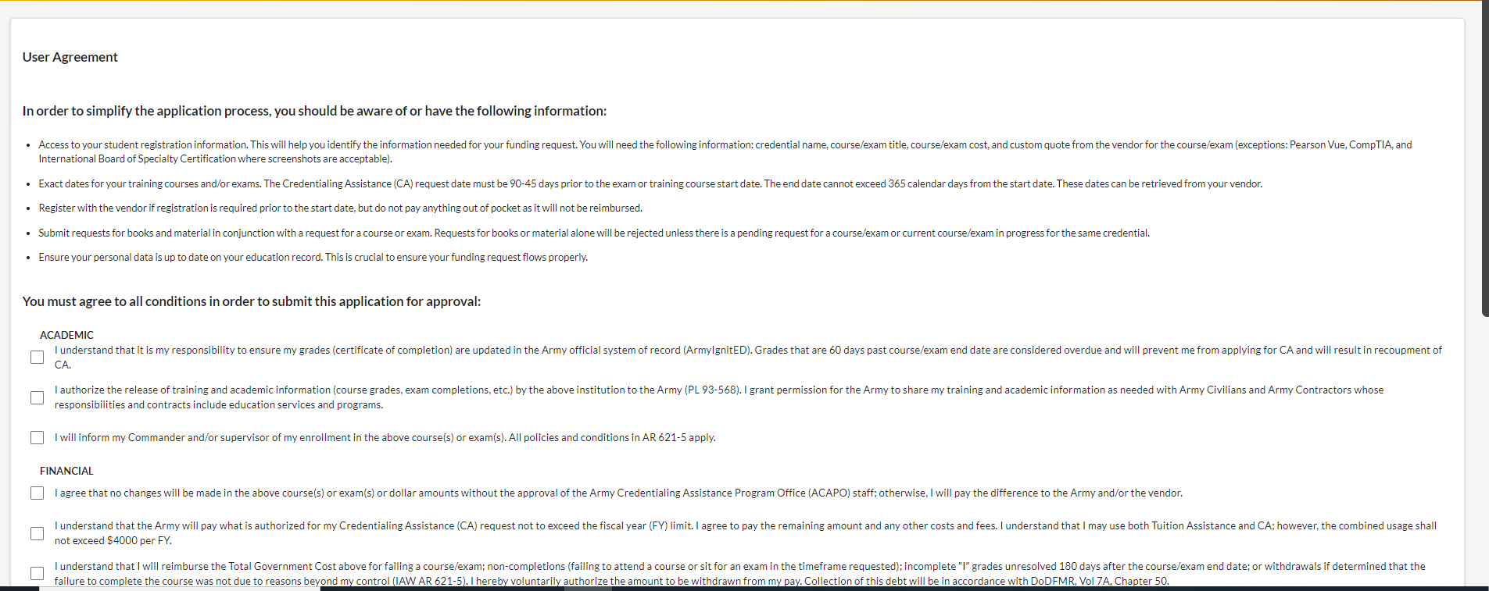
Credentialing Assistance
They’ll be brought to
this page where they
will accept the user
agreement

Slide 10
Credentialing Assistance
They’ll be asked if
they are applying from
a deployable location

Slide 11
Credentialing Assistance
Here they’ll put in their
vendor name and what
campus
As mentioned before,
if they are not an
approved vendor,
the SM will not find
them when they go to
input the vendor name
The SM can request
for the vendor to be
added to the approved
vendor list

Slide 12
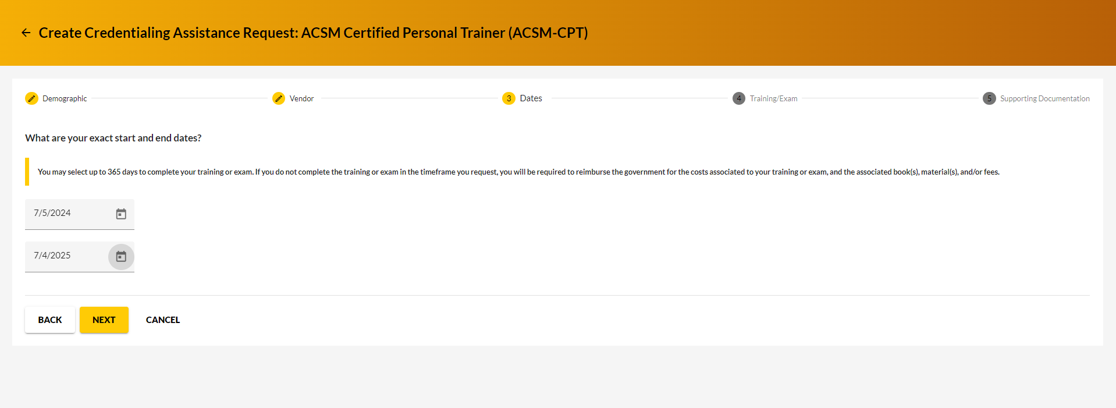
Credentialing Assistance
They’ll input the
credential start and
end dates here
*An important thing to
note for CA requests,
the SM must input a
start date of at least 45
days from the date
they are submitting the
request
They must also
complete the
credential within 365
days

Slide 13
Credentialing Assistance
Here they will select
whether the
credential is an exam
or if it training

Slide 14
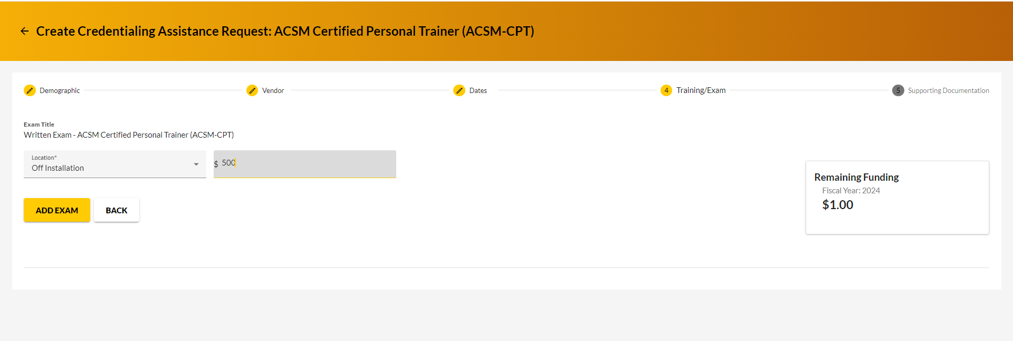
Credentialing Assistance
They will select the
location. If they are
taking the credential
on a military base, that
is the only time they
will select “On
Installation”
They will also put the
cost of the credential
here

Slide 15
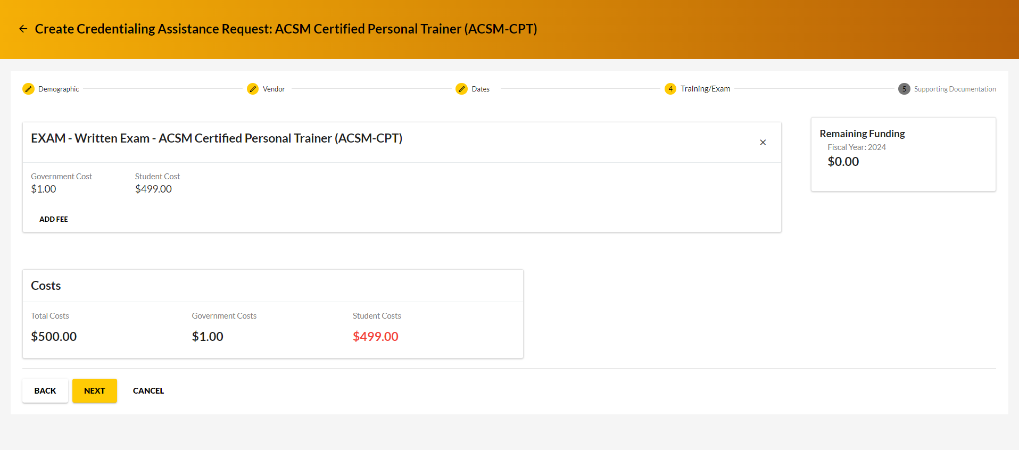
Credentialing Assistance
They will be brought
to this screen where
it will show the costs
to the government
and costs to the
student

Slide 16
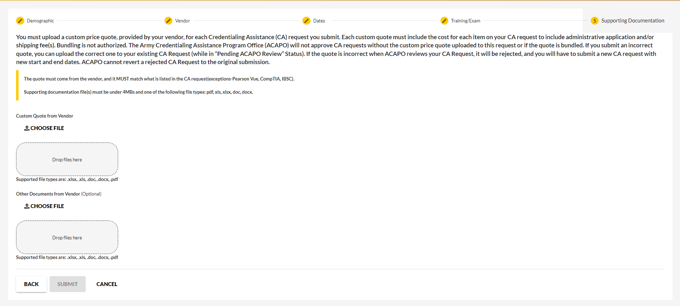
Credentialing Assistance
Here is where they
will upload necessary
documentation
Students must have
an invoice from them
vendor to upload here
If they do not have the
invoice, their CA
request may not be
approved
After they upload
the necessary
documents, they can
hit submit

